Slide 1

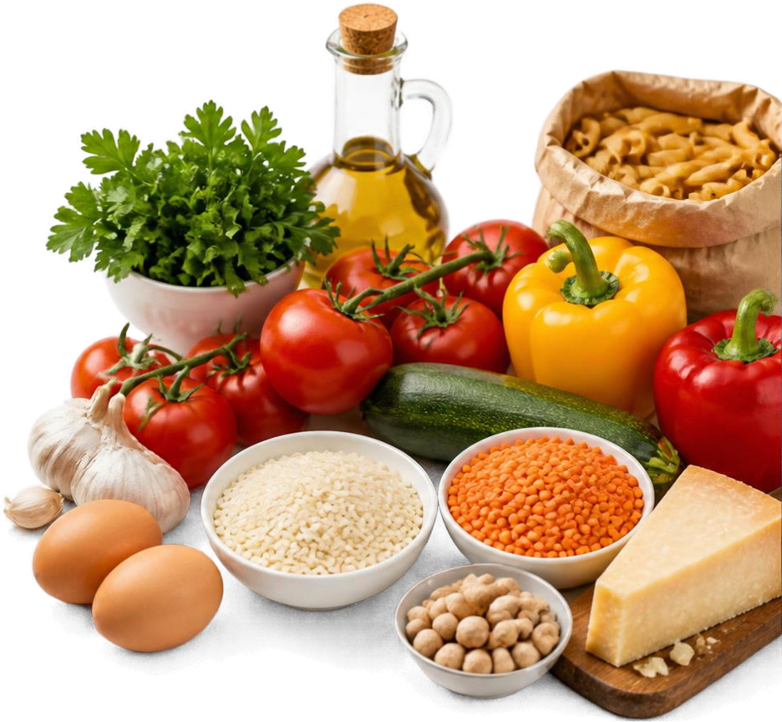
Food Ingredient Purchase Optimizer
Maximizing Menu Coverage & Minimizing Waste within Budget
PRESENTED BY:
Y.Akshaya-25MVCSMR0274
M.Rajeshwari-25MVCSMR0239
D.Maithreyee-25MVCSMR0213
K.Eekshanika-25MVCSMRO236

Slide 2

Problem Statement
Selecting ingredient purchases under a fixed budget to maximize menu coverage and reduce expected waste.
Budget constraint
for ingredient purchase
Maximize
coverage of menu items
Minimize
expected ingredient waste

Slide 3





Core Algorithms
Knapaack Algorithm
01
Finds the best combination of ingredients to maximize total value within the budget.
Greedy Selection
02
Picks the most valuable options step by step using a defined heuristic.
Sorting
03
Orders ingredients by cost, priority, or waste to support faster, smarter decisions.
Stronger Decisions
04
These algorithms work together to improve coverage, control costs, and reduce waste.

Slide 4









Prototype Architecture & Technologies
A modular system that turns ingredient data and budget inputs into optimized purchase recommendations.
01
DATA STORAGE
02
ALGORITHM IMPLEMENTATION
03
USER INTERFACE
SQLite
Python
Streamlit
Stores ingredient information, costs, and menu requirements.
Implements knapssck, greedy, and sorting algorithms to find the best purchase set.
Provides an interactive interface for selection, analysis, and results visualization.
ITERATE & REFINE

Slide 5





Results and
Decision Explanation
Greedy Heuristic
Knapsack Optimization
+23%
Ingredient
Qty
Est. Cost
Ingredient
Qty
Est. Cost
Chicken Breast
Rice
Tomatoes
Onions
Lettuce
8 kg
10 kg
6 kg
5 kg
3 kg
$24.00
$12.00
$9.00
$6.00
$7.00
Chicken Breast
Black Beans
Rice
Bell Peppers
Spinach
Tomatoes
7 kg
6 kg
8 kg
5 kg
4 kg
4 kg
$21.00
$9.00
$9.60
$7.50
$4.80
$6.00
higher menu coverage
-10.3%
lower expected waste
Total Cost
$58.00
Total Cost
$57.90
$0.10
Menu Coverage
62%
Menu Coverage
85%
Expected Waste
18.5%
Expected Waste
8.2%
under budget

Slide 6

Summary and Next Steps
Effective ingredient selection
improves menu coverage within budget
Kapsack and greedy approaches
offer different trade-offs
Prototype demonstrates clear, understandable optimization decisions

